Slide 1

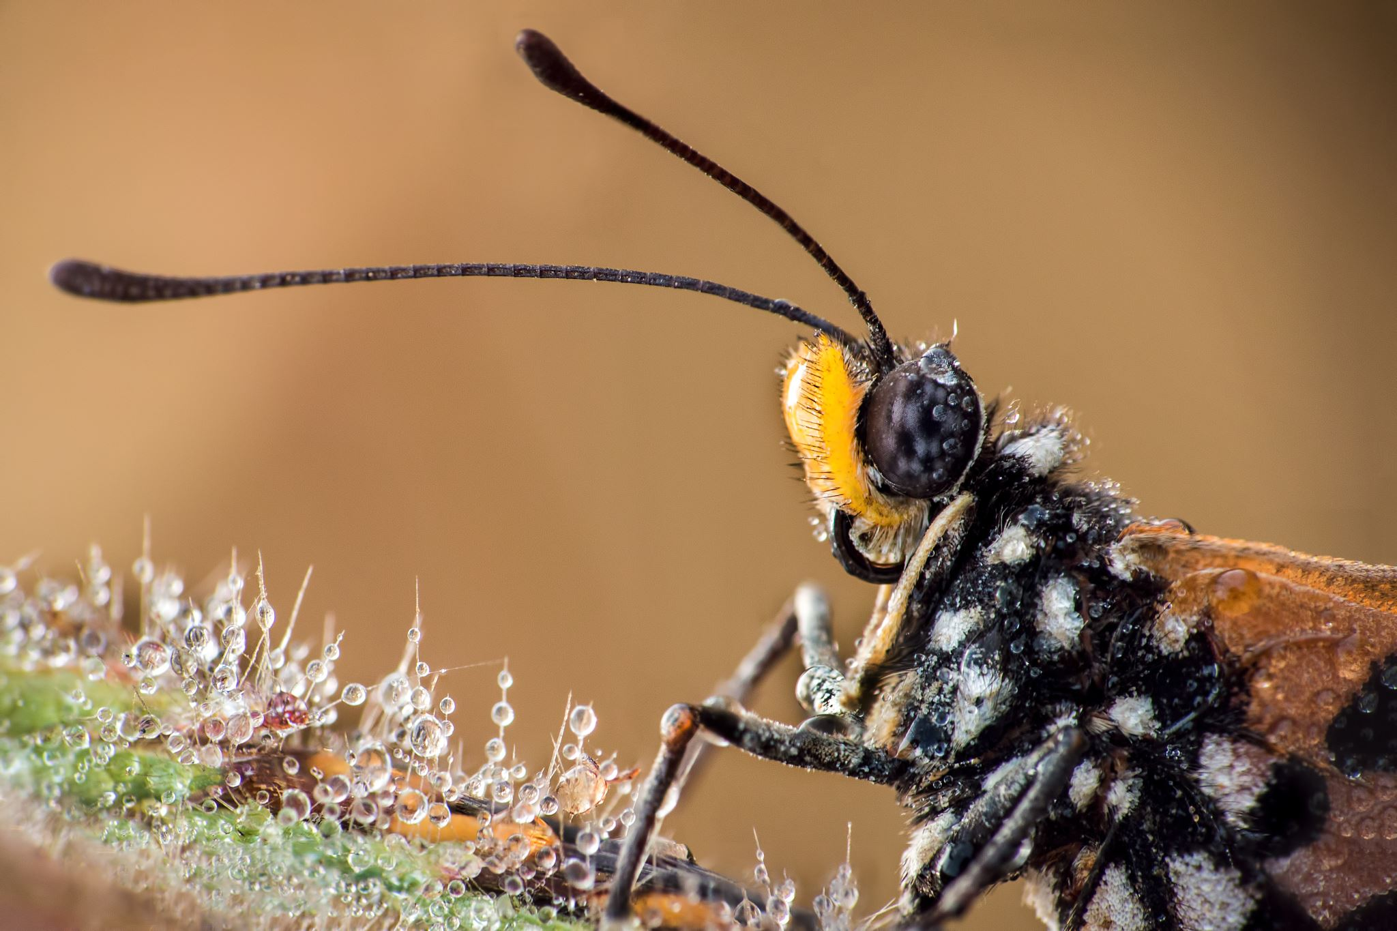


Living things and their habitats
For parents
Thank you for supporting your child’s learning in science.
Before the session:
Please read slide 2 so you know what your child is learning and what you need to get ready.
You may like to print slide 5.
As an alternative to squared paper, slide 6 may be printed for your child to record on.
During the session:
Share the learning intentions on slide 2.
Support your child in conducting an outside survey of garden invertebrates (if it is possible for your family).
Slide 7 has further, optional activities.
Slide 8 has a glossary of key terms.
Reviewing with your child:
Slide 8 gives an idea of what your child may produce.
Animals without a backbone:
Classifying invertebrates
Year 6
Age 10-11

Slide 2
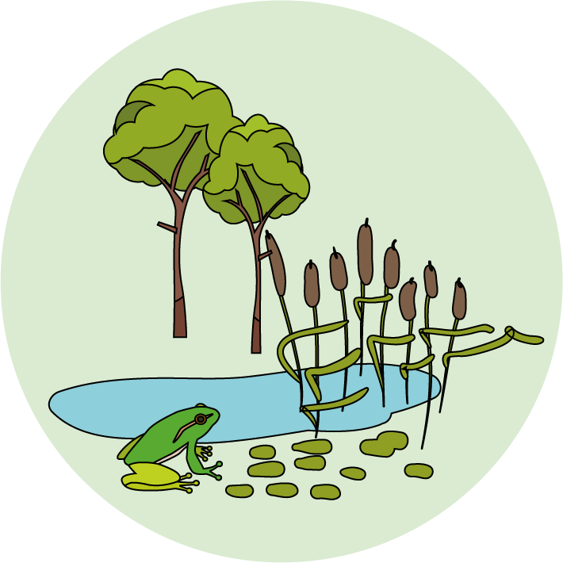

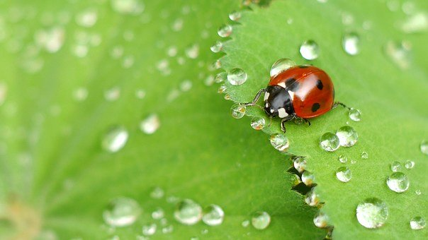
Living things and their habitats
Logo for section to sit inside roundel
Animals without a backbone: Invertebrates
Key Learning
Animals can be divided into two main groups: vertebrates (animals with backbones) and invertebrates (animals without backbones).
Invertebrates can be divided into many groups. These groups include insects, slugs & snails (molluscs), spiders (arachnids) and worms.
Activity & Investigation (pages 3-6): 30 - 40 mins
Use lined paper, squared paper, a ruler and a pencil.
Alternatively, print page 5 and 6 as worksheets.
Taking it further… (page 6): 30 - 60 mins
Making a branching key for garden invertebrates.
You may like to consider entering the Great Bug Hunt competition.
I can…
Describe some characteristics of invertebrates found in gardens, parks and woodland.
Use a tally chart to record data.
Plot a bar graph.
2

Slide 3
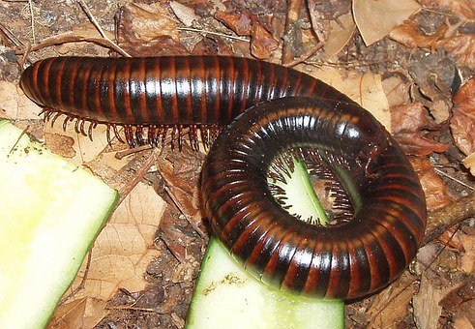
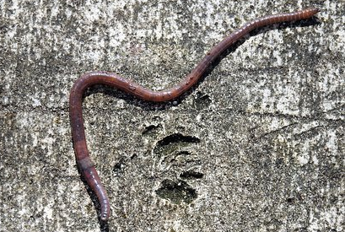
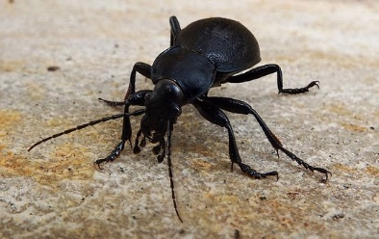
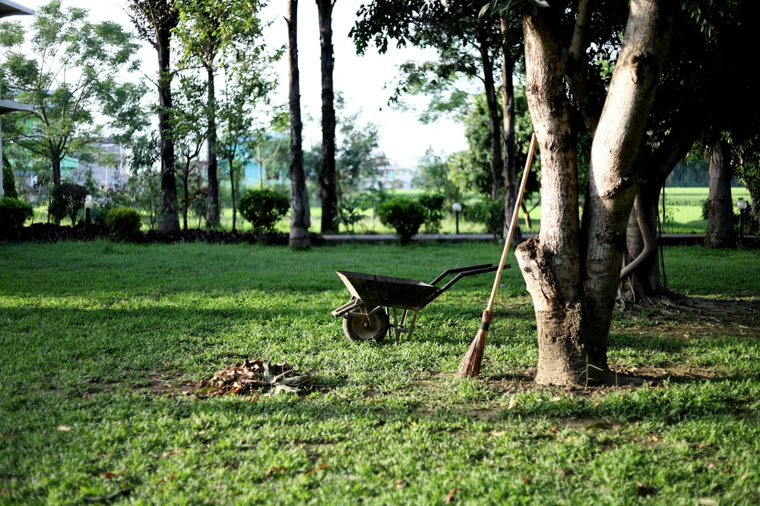

Explore, review, think, talk….
Logo for section to sit inside roundel
What do you already know about animals without backbones?
(10 minutes)
Animals without a backbone are called invertebrates.
Look carefully at these three invertebrates. Which one do you think is the odd one out?
Think about their features or characteristics to help you.
You may have chosen body colour, number of legs or body shape to describe the odd one out.
Some invertebrates have a hard exoskeleton to protect them. Watch this BBC clip to find out more. https://www.bbc.co.uk/bitesize/clips/zmj8q6f
Earthworms do not have an exoskeleton. They have flexible muscle for moving underground. https://www.nhm.ac.uk/discover/earthworm-heroes.html
Think or talk about two reasons why earthworms are important in a garden.
millipede
earthworm
beetle
3

Slide 4
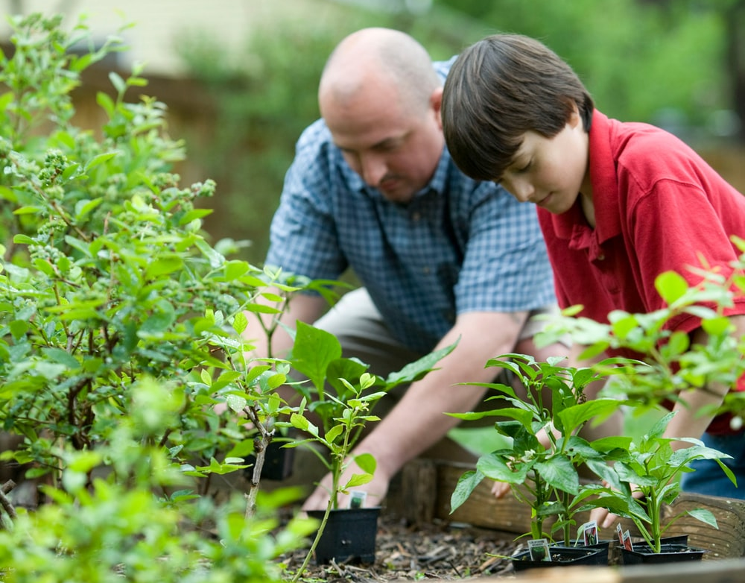
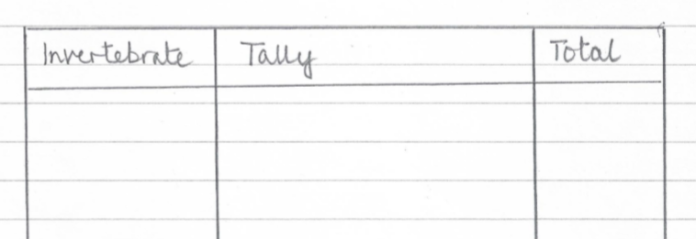
Garden and woodland invertebrates
Logo for section to sit inside roundel
Observing invertebrates by conducting a survey or using a secondary source
(Page 4-6: 40 minutes)
There are a huge variety of invertebrates in gardens, parks and woodlands around the UK.
If you have access to a garden, conduct a survey of invertebrates by looking under logs, stones, bushes or loose soil. You may also see some flying insects.
Use the identification key on page 5 to help you.
Make a tally chart of the invertebrates you find.
Ask an adult to help you plan and conduct the survey.
Follow government guidelines on social distancing and staying safe.
Take care with the animals you find. Avoid touching them, especially those which might bite or sting.
Remember to leave the animals in their habitat.
If you are unable to go outside, find out more about woodland invertebrates here: https://www.woodlandtrust.org.uk/trees-woods-and-wildlife/animals/other-invertebrates/
4

Slide 5
Conducting a survey of garden or woodland invertebrates.
Ask an adult to help you plan and conduct the survey. Follow government guidelines on social distancing and staying safe.
Take care with the animals you find. Avoid touching them, especially those which might bite or sting. Leave the animals in their habitat.
Invertebrate | Tally | Total
5

Slide 6
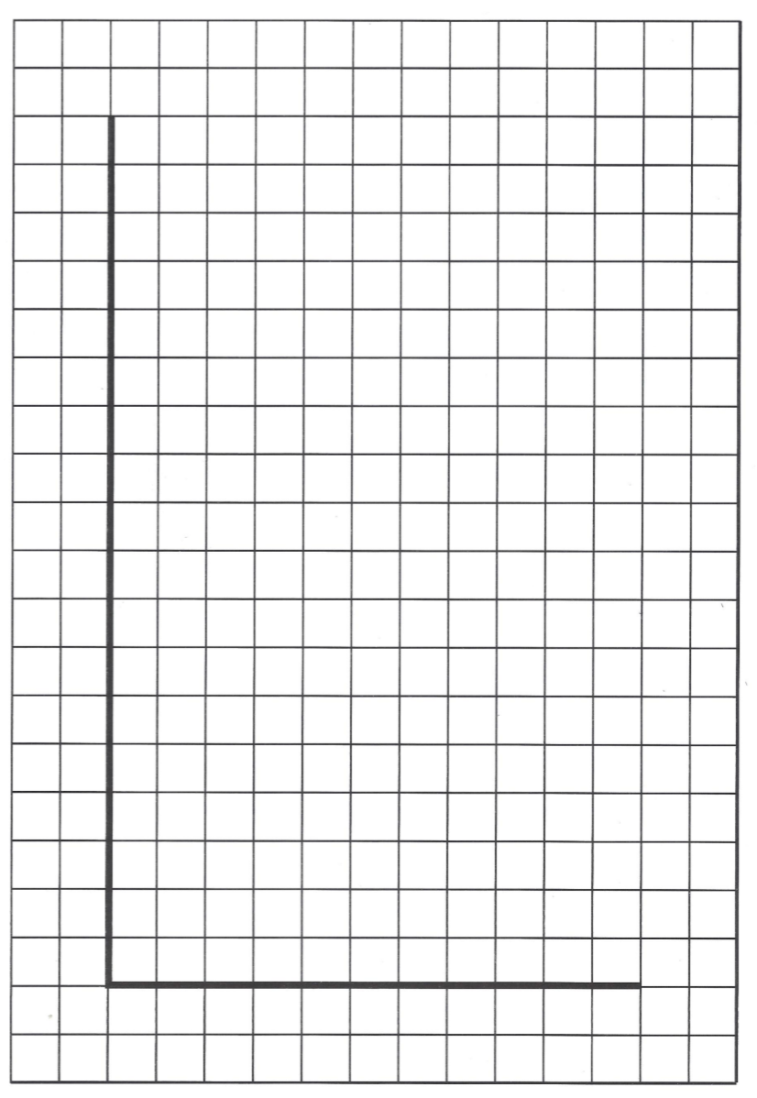
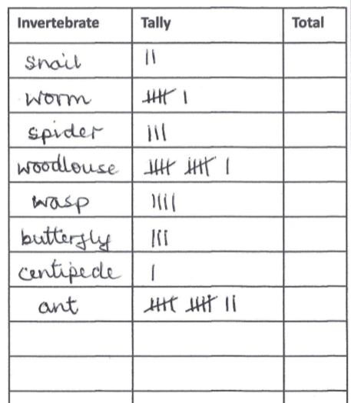
Make a bar chart to show the invertebrates you found in your survey.
Alternatively, use this data:
Invertebrates found in a garden on a warm day in April
I can plot a bar graph using survey data.
Remember to label the axes and give your bar chart a title.
6

Slide 7
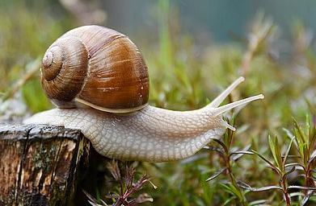
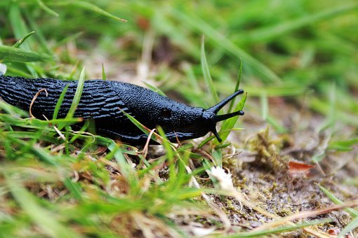
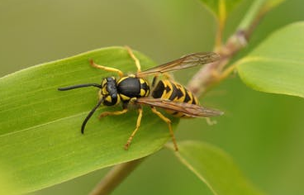
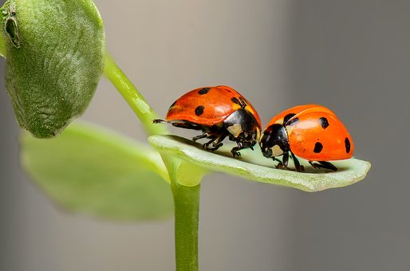
Taking it further…
Logo for section to sit inside roundel
You may like make a branching key or share your findings with the Great Bug Hunt
(30-60 minutes)
You have already learnt how to make a branching key for vertebrates.
Select four invertebrates from the identification key on page 5, or from your own survey.
For example: a sail, a slug, a wasp and a beetle.
Look carefully their features:
  How many legs to they have?
  Do they have wings?
  Do they have a exoskeleton?
  Do they have a shell?
Make a branching key to classify them.
The Great Bug Hunt is run every year by the ASE in partnership with the Royal Entomological Society.
For 2020, it is open for entries from home.
All details can be found here:
http://www.schoolscience.co.uk/bughunt
7

Slide 8
Glossary of terms
Characteristic: Characteristics are features of living things which help scientists classify them.
Classification: Classification is the method scientists use to group living things.
Exoskeleton: An exoskeleton is a hard outer casing which supports and protects the body of some invertebrates.
Identification key: An identification key is a useful tool for identifying unknown living things.
Invertebrate: An invertebrate is an animal without a backbone.
Survey: Scientific surveys are a common method used to collect data about living things.
Vertebrate: A vertebrate is an animal with a backbone.
8

Slide 9
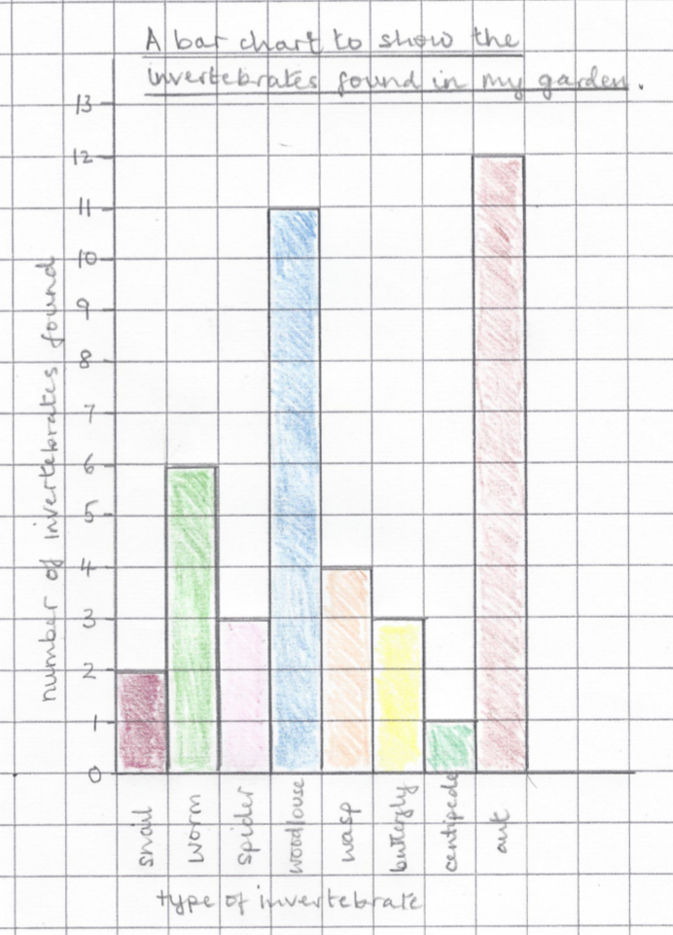
Possible learning outcome for reviewing your work.
I can plot a bar graph using survey data.
Each bar should be labelled with the name of the invertebrate, or a shortened code.
For example:
sna = snail.
Amphibians include frogs, toads and newts. They have a smooth moist skin and are cold blooded. They lay soft jelly-like eggs and can live on land and in the water.
Your graph may look different.
For example,
if you found a large number of invertebrates your scale may be numbered in intervals of 2s, 5s or 10s.
The x-axis needs a label, such as “type of invertebrate”
Check your numbers are evenly spaced along the y-axis.
The y-axis also needs a label, such as “number of invertebrates found”.
The graph should have a title, such as “A bar chart to show the invertebrates found in my garden”.
9

